Slide 1

NML Progress
OGF 30, Brussels

Slide 2
OGF IPR Policies Apply
“I acknowledge that participation in this meeting is subject to the OGF Intellectual Property Policy.”
Intellectual Property Notices Note Well: All statements related to the activities of the OGF and addressed to the OGF are subject to all provisions of Appendix B of GFD-C.1, which grants to the OGF and its participants certain licenses and rights in such statements. Such statements include verbal statements in OGF meetings […]
Excerpt from Appendix B of GFD-C.1: ”Where the OGF knows of rights, or claimed rights, the OGF secretariat shall attempt to obtain from the claimant of such rights, a written assurance that upon approval by the GFSG of the relevant OGF document(s), any party will be able to obtain the right to implement, use and distribute the technology or works when implementing, using or distributing technology based upon the specific specification(s) under openly specified, reasonable, non-discriminatory terms. The working group or research group proposing the use of the technology with respect to which the proprietary rights are claimed may assist the OGF secretariat in this effort. The results of this procedure shall not affect advancement of document, except that the GFSG may defer approval where a delay may facilitate the obtaining of such assurances. The results will, however, be recorded by the OGF Secretariat, and made available. The GFSG may also direct that a summary of the results be included in any GFD published containing the specification.”
Notes:
IPR Notices Note Well for OGF meetings

Slide 3
OGF IPR Policies Apply
Some works (e.g., works of the U.S. government) are not subject to copyright. However, to the extent that the submission is or may be subject to copyright, the contributor, the organization he or she represents (if any), and the owners of any proprietary rights in the contribution grant an unlimited perpetual, non-exclusive, royalty-free, worldwide right and license to the Open Grid Forum under any copyrights in the contribution. This license includes the right to copy, publish, and distribute the contribution in any way and to prepare derivative works that are based on or incorporate all or part of the contribution, the license to such derivative works to be of the same scope as the license of the original contribution.
The contributor acknowledges that the Open Grid Forum has no duty to publish or otherwise use or disseminate any contribution.
The contributor grants permission to reference the name(s) and address(es) of the contributor(s) and of the organization(s) he or she represents (if any).
The contributor represents that contribution properly acknowledges major contributors.
The contributor, the organization (if any) he or she represents, and the owners of any proprietary rights in the contribution agree that no information in the contribution is confidential and that the Open Grid Forum and its affiliated organizations may freely disclose any information in the contribution.
The contributor represents that he or she has disclosed the existence of any proprietary or intellectual property rights in the contribution that are reasonably and personally known to the contributor. The contributor does not represent that he or she personally knows of all potentially pertinent proprietary and intellectual property rights owned or claimed by the organization he or she represents (if any) or by third parties.
If you scream “chocolate” now, Freek will buy you a box of Belgium chocolate.
The contributor represents that there are no limits to the contributor's ability to make the grants acknowledgments and agreements above that are reasonably and personally known to the contributor.
Notes:
IPR Notices Note Well for OGF meetings

Slide 4
Agenda
This page unintentionally left blank

Slide 5
OGF27: Topical Volunteers
Device / Node / Port concepts
Network / Topology / Domain concept Inder, Jeroen
Adaptation / Layer concept Freek, Jeroen
Capabilities / Service concept Martin
Link / Path / Segment concepts Martin, Chin
Syntax representation, Identifiers Freek
Cross-connects and channels

Slide 6
OGF28: Topical Volunteers
Device / Node / Port concepts
Network / Topology / Domain concept
Capabilities / Service concept
Adaptation / Layer refinement Freek, Jeroen
Link / Path / Segment concepts Martin, Chin
Syntax representation, Identifiers Freek
Cross-connects and channels Jerry, Freek

Slide 7
OGF29: Topical Volunteers
Names and definitions of the relations between local and global identifiers Martin
Global unique identifier issues Freek & Inder
Implications of unidirectional topologies Martin & Gigi
Use-case for protection John MacAuley
Revise definition of multiplexing Jerry & Freek
Setup a teleconference Jeroen
Apply the schema to the Dynamic Gole demonstration Vangelis & Jeroen
Write a spec on the delegation of urn:ogf namespace Freek & Richard
On Monday, Chin, Freek, Guy, Inder, Jason, Jeroen, and John had an ad-hoc meeting.
Notes:
On Monday, Chin, Inder, Guy, Jeroen, Jason, Freek, John

Slide 8
Agenda Revised
Procedural
Future of NML
Editor(s) for schema document
Implementers
Technical
Identifier Syntax
Relations
Unidirectional / Bidirectional
Open Issues ⇠ Tomorrow

Slide 9
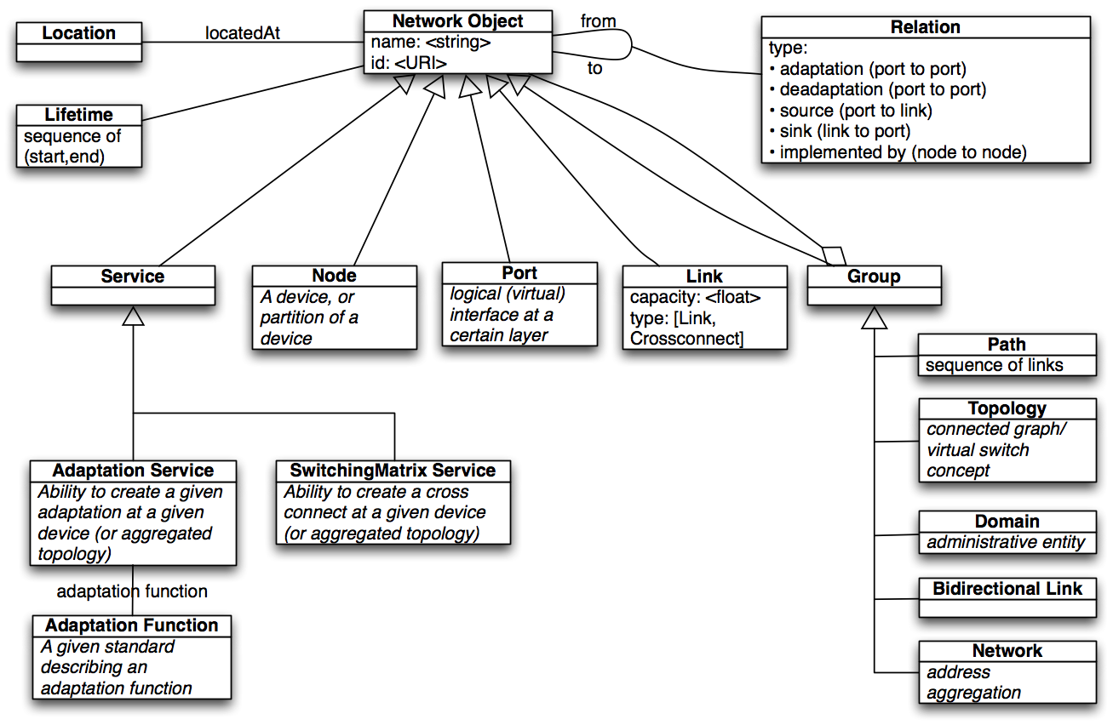
Current Schema

Slide 10
Future of NML-WG
Jeroen van der Ham

Slide 11
Working Group History
Started Feb 2007 (OGF 19)
Input from cNIS, UNIS, NDL, VXDL
Natural debates between people from different backgrounds
Published two documents (context and translation NDL-UNIS)
Some good progress when discussing subtopics
Little to no discussion on mailing list
Little to no commits from discussion to document

Slide 12
Working Group Future
Some new faces (Chin Guok, …), some missing (Martin Swany, …), some left (Anand Patil, …)
Need: Modellers → Implementers
Jeroen van der Ham likes to focus on research
“Is NML useful to you?”
“Yes, we are going to use it!”
“Great, are you going to implement it?”
“No, we wait for someone else to do it.”
Notes:
People who want to implement it, are mostly interested in mapping from user request to topology, and provisioning that (=NSI)

Slide 13
Identifiers
Contributors Monday’s Ad-Hoc Meeting

Slide 14
Identifiers
Object Namespace (Follows GFD-C.084):
http://schemas.ogf.org/nml/2013/10/base/
Instance Identifiers (After GLIF usage):
<Instance Identifier> ::= "urn:ogf:network:" <domain part> ":" <local part>
Follow RFC 2141/RFC 3987? (International URI)
Case insensitive?

Slide 15
Identifiers in XML
<topology xmlns:nml=“http://schemas.ogf.org/nml/2013/10/base/>
<nml:link id=“urn:ogf:network:es.net:e2epath_0912483”>
<relation type=“serialcompound”>
<nml:link refid=“urn:ogf:network:es.net:segment_1324”/>
<nml:link refid=“urn:ogf:network:internet2.edu:AF23895D”/>
</relation>
</nml:link>
<nml:link id=“urn:ogf:network:es.net:segment_1324”>
<nml:source refid=“urn:ogf:network:es.net:star-sd1:xe-1/0”/>
<nml:sink refid=“urn:ogf:network:es.net:chi-rtr1:xe-0/2”/>
</nml:link>
Does not use XML build-in idref, because that is limited to references within a document.

Slide 16
Relations
Contributors Monday’s Ad-Hoc Meeting

Slide 17
Scenario 1/2
Ethernet Switch
Ethernet Switch
Ethernet Switch
Optical
Cross
Connect
Optical
Cross
Connect
fibers

Slide 18
Scenario 2/2
VLAN 11
VLAN 8
VLAN 8
Ethernet Switch
Ethernet Switch
Ethernet Switch
Optical
Cross
Connect
Optical
Cross
Connect

Slide 19
Relations: Serial Compound
Link BCD is comprised of link B, link C2 and link D:
<nml:link id=“urn:ogf:network:example.net:BCD”>
<nml:relation type=“serial_compound”>
<nml:link refid=“urn:ogf:network:example.net:B”/>
<nml:link refid=“urn:ogf:network:example.net:C2”/>
<nml:link refid=“urn:ogf:network:example.net:D”/>
</nml:relation>
</nml:link>
A
B
C1
D
C2
C3

Slide 20
Relations: Parallel Compound
Link C is aggregated of link C1, link C2 and link C2
(e.g.multipath, protection or link aggregation):
<nml:link id=“urn:ogf:network:example.net:C”>
<nml:relation type=“parallel_compound”>
<nml:link refid=“urn:ogf:network:example.net:C1”/>
<nml:link refid=“urn:ogf:network:example.net:C2”/>
<nml:link refid=“urn:ogf:network:example.net:C3”/>
</nml:relation>
</nml:link>
A
B
C1
D
C2
C3

Slide 21
Relations: Adaptation
VLAN 8 (between bcd) is provided by link BCD,
VLAN 11 is provided by link BCD
VLAN 11
<nml:link id=“urn:ogf:network:example.net:VLAN8bcd”>
<nml:relation type=“adaptation”>
<nml:link refid=“urn:ogf:network:example.net:BCD”/>
</nml:relation>
</nml:link>
<nml:link id=“urn:ogf:network:example.net:VLAN11”>
<nml:relation type=“adaptation”>
<nml:link refid=“urn:ogf:network:example.net:BCD”/>
</nml:relation>
</nml:link>
VLAN 8 (bcd)
A
B
C1
D
C2
C3

Slide 22
Relations: VLAN 8
VLAN 8 is comprised of VLAN8 (a) and VLAN8 (bcd)
VLAN 8 (a) is provided by link A
VLAN 11
VLAN 8 (a)
VLAN 8 (bcd)
A
B
C1
D
C2
C3

Slide 23
Relations: All Together Now
<nml:link id=“urn:ogf:network:example.net:VLAN8”>
<nml:relation type=“serial_compound”>
<nml:link refid=“urn:ogf:network:example.net:vlan8a”/>
<nml:link refid=“urn:ogf:network:example.net:vlan8bcd”/>
</nml:relation>
</nml:link>
<nml:link id=“urn:ogf:network:example.net:VLAN8a”>
<nml:relation type=“adaptation”>
<nml:link refid=“urn:ogf:network:example.net:A”/>
</nml:relation>
</nml:link>
<nml:link id=“urn:ogf:network:example.net:VLAN8bcd”>
<nml:relation type=“adaptation”>
<nml:link refid=“urn:ogf:network:example.net:BCD”/>
</nml:relation>
</nml:link>
<nml:link id=“urn:ogf:network:example.net:BCD”>
<nml:relation type=“serial_compound”>
<nml:link refid=“urn:ogf:network:example.net:B”/>
<nml:link refid=“urn:ogf:network:example.net:C”/>
<nml:link refid=“urn:ogf:network:example.net:D”/>
</nml:relation>
</nml:link>
<nml:link id=“urn:ogf:network:example.net:C”>
<nml:relation type=“parallel_compound”>
<nml:link refid=“urn:ogf:network:example.net:C1”/>
<nml:link refid=“urn:ogf:network:example.net:C2”/>
<nml:link refid=“urn:ogf:network:example.net:C3”/>
</nml:relation>
</nml:link>
VLAN 11
VLAN 8 (a)
VLAN 8 (bcd)
A
B
C1
D
C2
C3

Slide 24
Unidirectional vs. Bidirectional
Contributors Monday’s Ad-Hoc Meeting

Slide 25
Previous Decision
All objects (link, port, …) are unidirectional
This is required for e.g. layer 3, and probably useful for monitoring
Most resources and user requests are bidirectional
We can Group two unidirectional links to a bidirectional link.
This now allows to name a bidirectional link
No other attributes are defined for a bidirectional link.

Slide 26
Bidirectional Link
BidirectionalLink is a Group subclass.
<nml:bidirectionallink>
<nml:link refid=“urn:ogf:network:es.net:link_A_to_B”/>
<nml:link refid=“urn:ogf:network:es.net:link_B_to_A”/>
</nml:bidirectionallink>
<nml:link id=“urn:ogf:network:es.net:link_A_to_B”>
<nml:source refid=“urn:ogf:network:es.net:A-1/1-egress”/>
<nml:sink refid=“urn:ogf:network:es.net:B-1/2-ingress”/>
</nml:link>
<nml:link id=“urn:ogf:network:es.net:link_B_to_A”>
<nml:source refid=“urn:ogf:network:es.net:B-1/2-egress”/>
<nml:sink refid=“urn:ogf:network:es.net:A-1/1-ingress”/>
</nml:link>

Slide 27
Proposal 1
Name the subclass “Bidirectional”
Also allow it for Ports
(Need better name for VLAN support?)
<nml:bidirectional id=“urn:ogf:network:es.net:link_A-B”>
<nml:link refid=“urn:ogf:network:es.net:link_A_to_B”/>
<nml:link refid=“urn:ogf:network:es.net:link_B_to_A”/>
</nml:bidirectional>
<nml:bidirectional id=“urn:ogf:network:es.net:port-1/2”>
<nml:port refid=“urn:ogf:network:es.net:1/2-ingress”/>
<nml:port refid=“urn:ogf:network:es.net:1/2-egress”/>
</nml:bidirectional>

Slide 28
Link A-B-C
<nml:bidirectional refid=“urn:ogf:network:es.net:bilink_A-C”>
<nml:link refid=“urn:ogf:network:es.net:link_A_to_C”/>
<nml:link refid=“urn:ogf:network:es.net:link_C_to_A”/>
</nml:bidirectional>
<nml:link id=“urn:ogf:network:es.net:link_A_to_C”>
<nml:relation type=“serialcompound”>
<nml:link refid=“urn:ogf:network:es.net:link_A_to_B”/>
<nml:link refid=“urn:ogf:network:es.net:link_B_to_C”/>
</nml:relation>
</nml:link>
<nml:link id=“urn:ogf:network:es.net:link_C_to_A”>
<nml:relation type=“serialcompound”>
<nml:link refid=“urn:ogf:network:es.net:link_C_to_B”/>
<nml:link refid=“urn:ogf:network:es.net:link_B_to_A”/>
</nml:relation>
</nml:link>

Slide 29
Link A-B-C: Proposal 2
<nml:bidirectional refid=“urn:ogf:network:es.net:bilink_A-C”>
<nml:relation type=“serialcompound”>
<nml:bidirectional refid=“urn:ogf:network:es.net:bilink_A-B”/>
<nml:bidirectional refid=“urn:ogf:network:es.net:bilink_B-C”/>
</nml:relation>
</nml:bidirectional>
<nml:bidirectional id=“urn:ogf:network:es.net:bilink_A-B”>
<nml:link refid=“urn:ogf:network:es.net:link_A_to_B”/>
<nml:link refid=“urn:ogf:network:es.net:link_B_to_A”/>
</nml:bidirectional>
<nml:bidirectional id=“urn:ogf:network:es.net:bilink_B-C”>
<nml:link refid=“urn:ogf:network:es.net:link_B_to_C”/>
<nml:link refid=“urn:ogf:network:es.net:link_C_to_B”/>
</nml:bidirectional>
<nml:bidirectional refid=“urn:ogf:network:es.net:bilink_A-C”>
<nml:relation type=“serialcompound”>
<nml:bidirectional refid=“urn:ogf:network:es.net:bilink_A-B”/>
<nml:bidirectional refid=“urn:ogf:network:es.net:bilink_B-C”/>
</nml:relation>
</nml:bidirectional>
Do not allow relations between groups, only between links/ports/nodes.

Slide 30
Open Issues

Slide 31
Open Issues
For adaptation, parallel compound relations: how to specify properties of these relations? (e.g. type of adaptation, or type of protection/link aggregation)
For serial compound relations: do cross connects need to be specified or only the links?
Is the adaptation relation between links or between ports, or either?
Notes:
Characteristic Information is defined in G.800

Slide 32
Cross Connect Discussion
Jerry Sobiesky and Freek Dijkstra

Slide 33
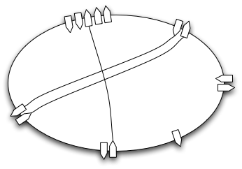
Basic Properties
Input Ports
Output Ports
Transport Function

Slide 34
Functions
Transport Function: Move data, but do not change it.
Transform Function: Change data (adaptation, label conversion), but do not move it.
Transfer Function: You tell me!? (this was used in NML/NSI discussion yesterday)

Slide 35
Questions
Are input and output ports distinct?
Do they have a different name, even for bidirectional physical ports?
Where does (de)multiplexing take place?
Is it part of the Switch Matrix, or separate?
What Functions does a Switch Matrix have?
Transport Function
Label Conversion
Adaptation

Slide 36
Channels

Slide 37
Channels
G.800:
Link port
Forwarding port
How does this map to NML “Port”?
How does this relate to NSI “STP”?

Slide 38
Multi-Layer Path Use Cases
Freek Dijkstra

Slide 39
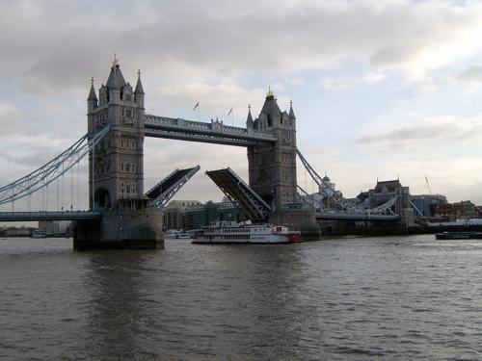
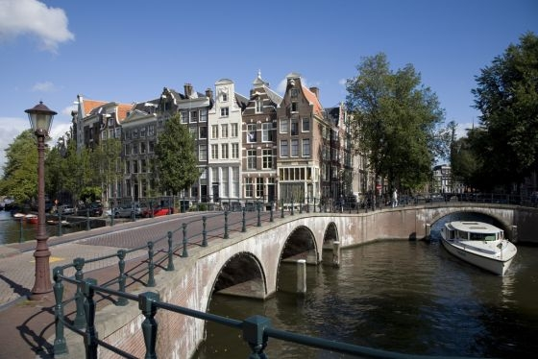
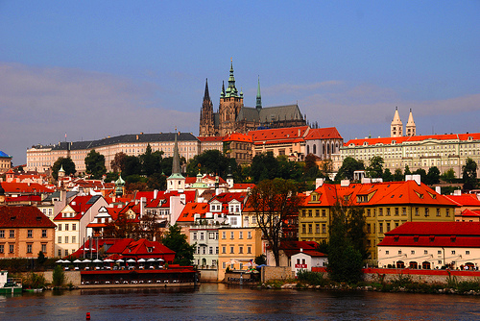
Use Case 1: Horizontal Partitioning
Phosporous circuit (now dismantled)
Geant2 used two names for two sections
NetherLight used one name for whole path
NetherLight: #5030LE
GEANT2: #07017
GEANT2: #07016
London
Amsterdam
Prague

Slide 40
Use Case 2: Vertical Partitioning
JIVE circuit C5
Runs over AARnet, CENIC, CANARIE, SURFnet, and others.
“CENIC service is provided by NLR”
JIVE: #C5
CENIC: #AUS-SEA-5
NLR: #NLR-LOSA-SEAT-O192-258
Narrabi
Sydney
Los Angelos
Seattle
New York
Amsterdam
Dwingeloo

Slide 41
Virtualisation Discussion
NSI discussion, really

Slide 42
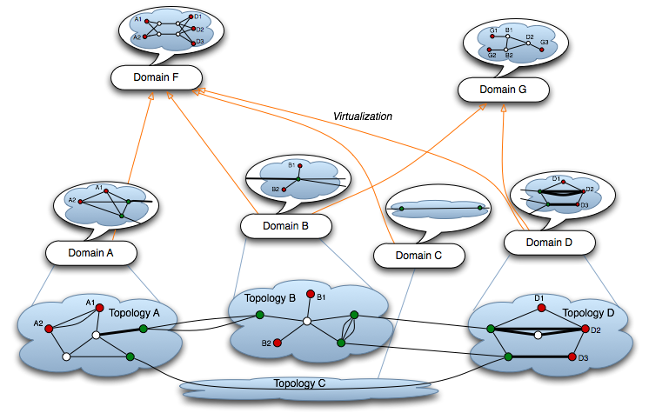
Virtualization

Slide 43
Addenda to Proposals

Slide 44
Yeah or Nay
Start
Current Proposal OK?
Authors willing to revise?
no
no
yes
yes
Integrate in document
Back to the drawing board
New volunteers

Slide 45
Some Questions
Network
Relation topology:domain 1:1, many:1 or 1:many?
Why is domain only for a network, considering the "any IT" mention in infrastructure service BoF?
Is there input from the recent topology discussion in the NSI?
Adaptation
no multiplexing/inverse multiplexing
Layer definition contains “collection of port”

Slide 46
Full Copyright Notice
Copyright (C) Open Grid Forum (2010). All Rights Reserved.
This document and translations of it may be copied and furnished to others, and derivative works that comment on or otherwise explain it or assist in its implementation may be prepared, copied, published and distributed, in whole or in part, without restriction of any kind, provided that the above copyright notice and this paragraph are included on all such copies and derivative works.
The limited permissions granted above are perpetual and will not be revoked by the OGF or its successors or assignees.
Notes:
OGF Full Copyright Notice if necessary

